Slide 1
VEHICLE DAMAGE DETECTOR
2026
By CYPHER
CSC03A3 MINI PROJECT

Slide 2
CONTRIBUTORS
221044447
222067338
223082890
223034847 | A.D. SAMVURA
P NNEKO
T NKOBANG
N GITTA

Slide 3
Table of contents
01
05
02
06
03
04
Problem Statement
Damage Classification
Program Overview
Damage Similarity
UI Overview
07
Visualization and Conclusions
Image Processing
08
Libraries and Algorithms used

Slide 4
01
Problem Statement

Slide 5

Problem Statement:
Fraud is a rampant issue in South Africa, particularly in the Vehicle Insurance field, where false damage is reported on vehicles often. Our project centre’s around remedying this by, sniffing out fraudulent insurance claims for vehicle damage. Through the use of both Similarity detection and Image Classification, we shall be able to deduce whether reported damage is in fact true or whether a fraudulent claim is being made. Users will input images into our program and in turn our system will be able conclude whether or not their vehicle is actually damaged or not

Slide 6
02
Program Overview

Slide 7
Overview
Step 1
Step 2
Step 3
User Inputs Image
Greyscale converted to patches
Image is converted to greyscale
Step 4
Step 5
Step 6
Patches converted to a RAG
RAG used to classify damage
Image checked for similarity with other damaged vehicles

Slide 8
03
UI OVERVIEW

Slide 9
UI OVERVIEW
User is greeted with a screen with 3 imageview’s 2 buttons 1 textview. The purpose of the imageview’s are to see the detected damage of the vehicles alongside the uploaded photo for reference. The three buttons allow users to do the following: - initiate damage analysis - clear their screen - save the detected damage view
The textview reports on the final conclusion, whether or not a vehicle is damaged

Slide 10
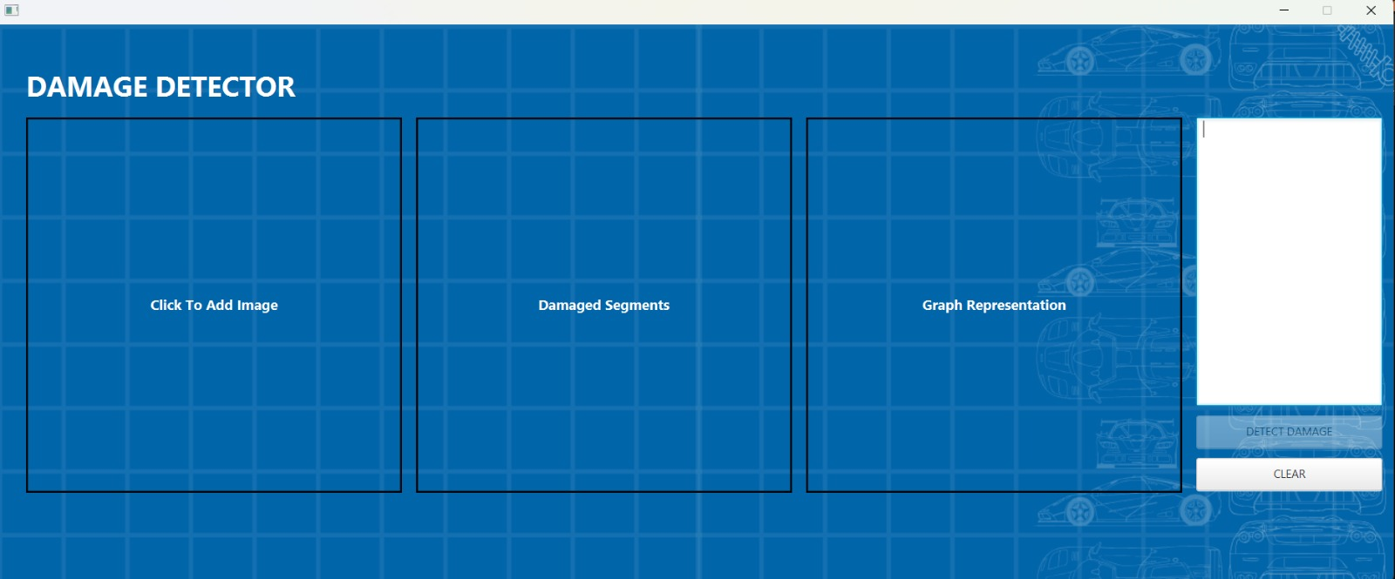
UI OVERVIEW

Slide 11
04
Image Processing

Slide 12
Greyscale Conversion
Our first step in processing our image is a conversion to greyscale. This simplifies our image and reduces processing by going from 3 separate RGB values to just one value. Namely, the intensity. We focus on how bright or dark regions are relative to each other

Slide 13
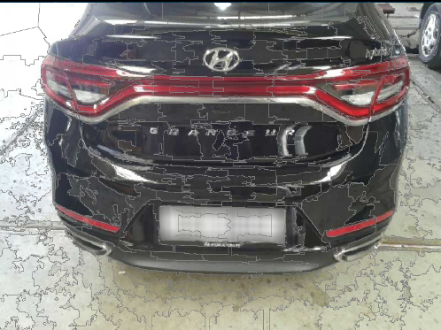
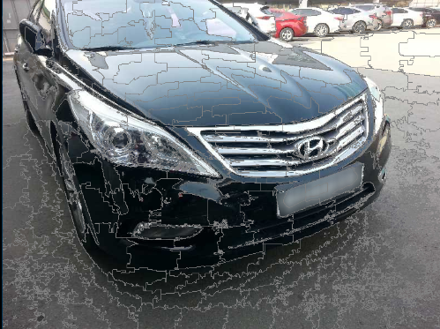
SLIC Super-pixel Segmentation
Images are made of thousands of pixels. Working with every single pixel directly would be computationally heavy. SLIC (simple linear iterative clustering) groups neighbouring pixels that look similar into patches called superpixels. The idea is that pixels within the same patch are probably part of the same surface.

Slide 14
Building Patchnodes
We need to know what each patch looks like so we can compare patches against each other. For every patch we compute its average intensity, centroid position, size, and texture variance. These properties become the properties of each node in the graph

Slide 15
05
Damage Classification

Slide 16
REGION ADJACENCY GRAPH
The RAG is a graph where each patch becomes a node and each edge connects two patches that are physically adjacent in the image. We use the patchnodes built to create the RAG. The weight of each edge is the intensity difference between the two patches it connects. This structure lets us see which boundaries in the image are unusually sharp or unexpected? A smooth undamaged car panel should have low-weight boundaries between its patches. Damage disrupts the surface and creates sharp, high-weight boundaries. It’s visualized within the third image view and it shows a graph structure built by the graphstream.

Slide 17
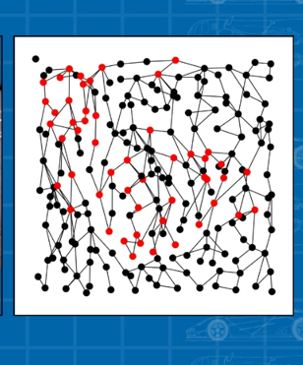
REGION ADJACENCY GRAPH
DAMAGE PRESENT
All patch nodes in black reperesenting undamaged patches All patchnodes in red representing damaged patches. Black lines reperesenting edges that connect each patch

Slide 18
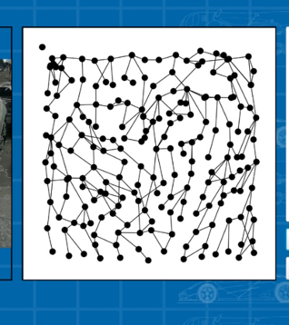
REGION ADJACENCY GRAPH
NO DAMAGE PRESENT
All patch nodes in black representing undamaged patches ZERO patchnodes in red Showing no damaged patches. Black lines representing edges that connect each patch

Slide 19
DAMAGE THRESHOLD SCORING
Not every edge in the RAG will represents damage. In our dataset we saw a lot of noise. Headlights, grilles, windows, and shadows all create natural high-contrast boundaries. So rather than flagging individual edges we score each patch based on how many strong edges surround it (EDGE_THRESHOLD) and how strong they are on average (DAMAGE_THRESHOLD). A patch that is surrounded by many high-weight edges is in a region of high local contrast, which is more likely to indicate damage than a single strong edge which could just be noise. We trial and errored values to discern what good thresholding values would be for vehicular damage.

Slide 20
06
Damage Similarity

Slide 21
Damage Similarity
For Similarity we first load images from the data folder in the project each of which is then converted into a RAG itself. We then compare the Intensities, edge weight and sizes of the damaged regions against all of the images in our data folder and then determine a similarity score and if that score is high enough we determine it is similar enough to be considered damaged.

Slide 22
Damage Similarity
For Similarity we first load images from the data folder in the project each of which is then converted into a RAG itself. We then compare the Intensities, edge weight and sizes of the damaged regions against all of the images in our data folder and then determine a similarity score and if that score is high enough we determine it is similar enough to be considered damaged.

Slide 23
0 7
Visualization and Conclusions

Slide 24
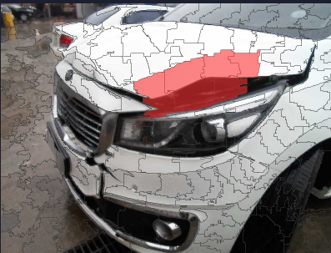
Damage Visualizer
We create a copy of the image with the patches imprinted in grey lines over it. We use the information from the RAG i.e. which pactches have been flagged, to pinpoint patches of interest. These patches are subsequently coloured with a red overlay to indicate and visualize damage.This red overlay is done through the use of a Alpha Blending Algorithm

Slide 25
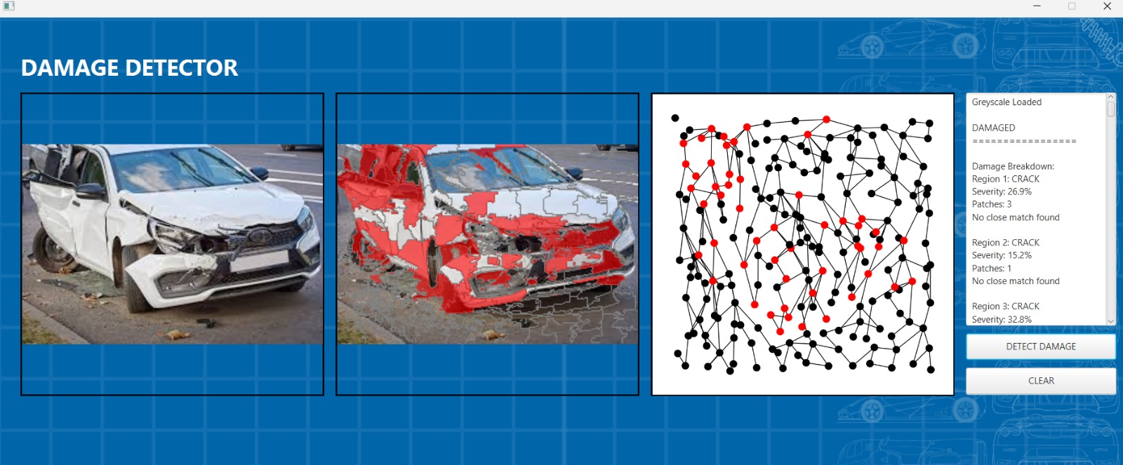
Damage Visualizer

Slide 26
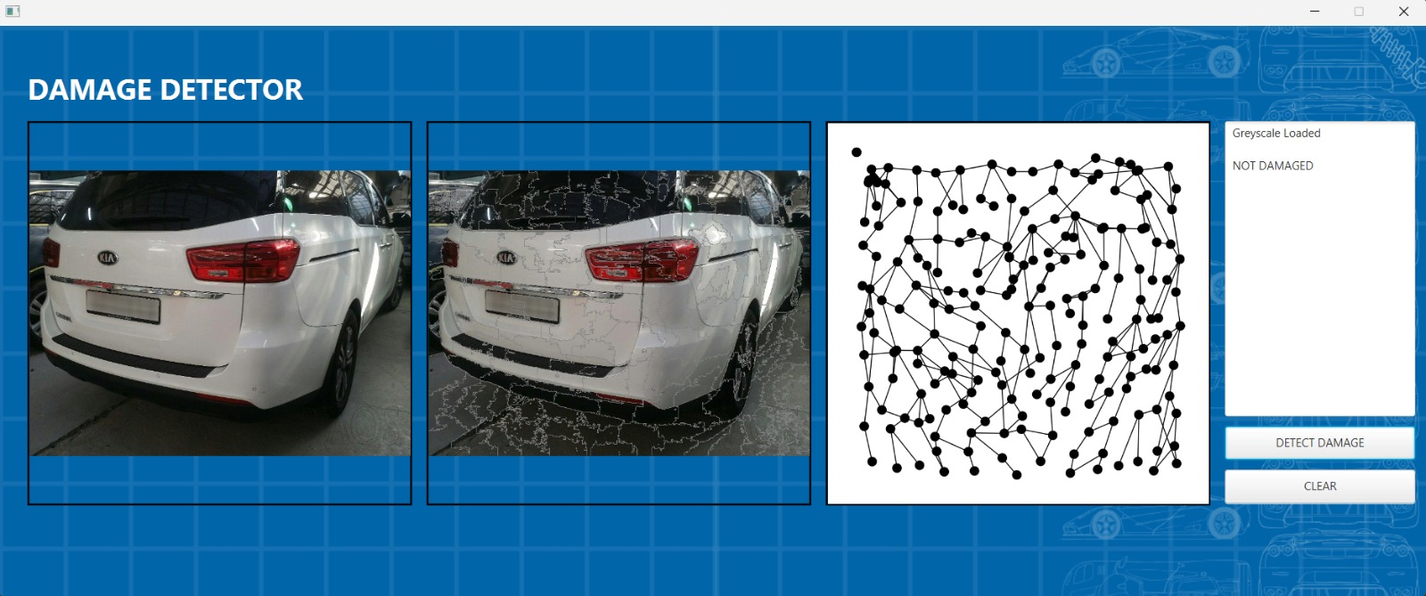
Damage Visualizer

Slide 27
CONCLUSION
If more than 3 patches are flagged, we move on to similarity and compare damage to known damage and get a similarity score. If the score is deemed high enough, the vehicle is flagged as damaged. Else the vehicle is flagged as undamaged

Slide 28
0 8
LIBRARIES AND ALGORITHMS

Slide 29
LIBRARIES AND ALGORTITHMS
ALGORITHMS SLIC — Simple Linear Iterative Clustering
Alpha Blending
BFS (Done to tie up loose ends after SLIC)
Greyscale
LIBRARIES
JavaFX
JavaAWT
JavaGraphStream

Slide 30
THANK YOU

